Slide 1
Combining Zooplankton Datasets

Slide 2
Inputs
EMP
FMWT
FRP
Flat files online
Environmental data and CPUE in same file
Combined Data Set
20mm
Access files online
Environmental data and counts are in separate files
CPUE needs to be calculated in code
Notes:
EMP, FMWT, and FRP Datasets
EMP and FMWT are in flat files online – simple to load into R with a line of code
counts are in the same file
20mm Dataset
20mm are in Access files – not as simple to load into R
CPUE is not calculated – must be done in code
Similar methods
Discrepancies in taxonomic classification and environmental variables

Slide 3
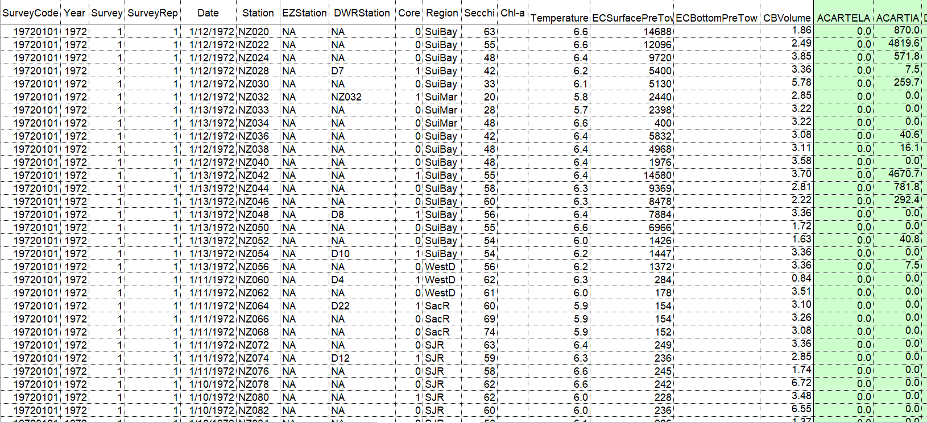
Input: Datasets
Notes:
This is one example from EMP

Slide 4
Some issues with integration:
Different environmental variables collected among datasets
Discrepancies in taxonomic classification
To resolve this:
Calculate the least common denominator (LCD) taxa using a crosswalk table and hierarchy table

Slide 5
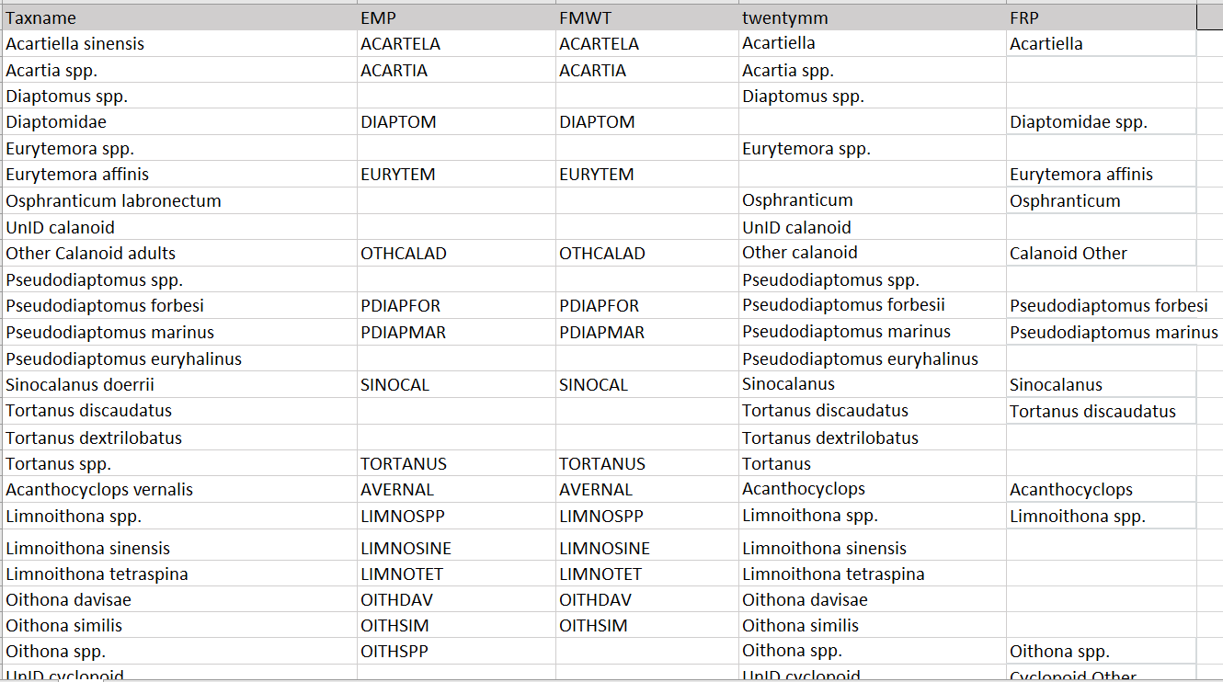
Crosswalk Table

Slide 6
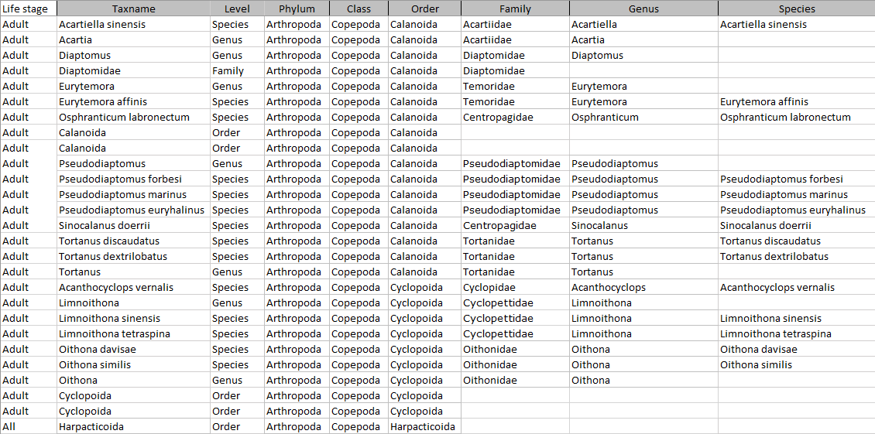
Hierarchy Table

Slide 7
Input data processing
Station | Volume | Taxa | CPUE
NZ020 | 1.8 | PDIAPFOR | 870
NZ020 | 2.5 | PDIAPFOR | 4819
NZ020 | 3.8 | PDIAPFOR | 571
NZ020 | 1.8 | OITHDAV | 0
NZ020 | 2.5 | OITHDAV | 0
NZ020 | 3.8 | OITHDAV | 0
Rename columns, gather rows
Station | CBVolume | PDIAPFOR | OITHDAV
NZ020 | 1.8 | 870 | 0
NZ020 | 2.5 | 4819 | 0
NZ020 | 3.8 | 571 | 0
Add taxonomic info, latitude, and longitude
Station | Volume | Lat | Long | Taxname | Genus | Family | …. | CPUE
NZ020 | 1.8 | 38.031 | -122.135 | Pseudodiaptomus forbesii | Pseudodiaptomus | Pseudodiaptomidae |  | 870
NZ020 | 2.5 | 38.031 | -122.135 | Pseudodiaptomus forbesii | Pseudodiaptomus | Pseudodiaptomidae |  | 4819
NZ020 | 3.8 | 38.031 | -122.135 | Pseudodiaptomus forbesii | Pseudodiaptomus | Pseudodiaptomidae |  | 571
NZ020 | 1.8 | 38.031 | -122.135 | Oithona davisae | Oithona | Oithonidae |  | 0
NZ020 | 2.5 | 38.031 | -122.135 | Oithona davisae | Oithona | Oithonidae |  | 0
NZ020 | 3.8 | 38.031 | -122.135 | Oithona davisae | Oithona | Oithonidae |  | 0

Slide 8
Merging datasets
Station | Volume | Taxname | Genus | Family | …. | CPUE
NZ020 | 1.8 | Pseudodiaptomus forbesii | Pseudodiaptomus | Pseudodiaptomidae |  | 870
NZ020 | 2.5 | Pseudodiaptomus forbesii | Pseudodiaptomus | Pseudodiaptomidae |  | 4819
NZ020 | 3.8 | Pseudodiaptomus forbesii | Pseudodiaptomus | Pseudodiaptomidae |  | 571
NZ020 | 1.8 | Oithona davisae | Oithona | Oithonidae |  | 0
NZ020 | 2.5 | Oithona davisae | Oithona | Oithonidae |  | 0
NZ020 | 3.8 | Oithona davisae | Oithona | Oithonidae |  | 0
Merge
Project | Station | Volume | Taxname | Genus | Family | …. | CPUE
EMP | NZ020 | 1.8 | Pseudodiaptomus forbesii | Pseudodiaptomus | Pseudodiaptomidae |  | 870
EMP | NZ020 | 2.5 | Pseudodiaptomus forbesii | Pseudodiaptomus | Pseudodiaptomidae |  | 4819
EMP | NZ020 | 3.8 | Pseudodiaptomus forbesii | Pseudodiaptomus | Pseudodiaptomidae |  | 571
EMP | NZ020 | 1.8 | Oithona davisae | Oithona | Oithonidae |  | 0
EMP | NZ020 | 2.5 | Oithona davisae | Oithona | Oithonidae |  | 0
EMP | NZ020 | 3.8 | Oithona davisae | Oithona | Oithonidae |  | 0
FMWT | 340 | 3.8 | Pseudodiaptomus forbesii | Pseudodiaptomus | Pseudodiaptomidae |  | 400
FMWT | 340 | 7.4 | Pseudodiaptomus forbesii | Pseudodiaptomus | Pseudodiaptomidae |  | 845
FMWT | 340 | 10.2 | Pseudodiaptomus forbesii | Pseudodiaptomus | Pseudodiaptomidae |  | 3147
FMWT | 340 | 3.8 | Oithona davisae | Oithona | Oithonidae |  | 58
FMWT | 340 | 7.4 | Oithona davisae | Oithona | Oithonidae |  | 852
FMWT | 340 | 10.2 | Oithona davisae | Oithona | Oithonidae |  | 1258
Station | Volume | Taxname | Genus | Family | …. | CPUE
340 | 3.8 | Pseudodiaptomus forbesii | Pseudodiaptomus | Pseudodiaptomidae |  | 400
340 | 7.4 | Pseudodiaptomus forbesii | Pseudodiaptomus | Pseudodiaptomidae |  | 845
340 | 10.2 | Pseudodiaptomus forbesii | Pseudodiaptomus | Pseudodiaptomidae |  | 3147
340 | 3.8 | Oithona davisae | Oithona | Oithonidae |  | 58
340 | 7.4 | Oithona davisae | Oithona | Oithonidae |  | 852
340 | 10.2 | Oithona davisae | Oithona | Oithonidae |  | 1258

Slide 9
Solving inconsistencies in taxonomic resolution
EMP
Pseudodiaptomus forbesii
Pseudodiaptomus marinus
FMWT
Pseudodiaptomus forbesii
Pseudodiaptomus marinus
20mm
Pseudodiaptomus spp.
Pseudodiaptomus forbesii
Pseudodiaptomus marinus
Pseudodiaptomus euryhalinus
+
+
+
All Pseudodiaptomus
All Pseudodiaptomus
All Pseudodiaptomus
Combined data
EMP | FMWT | 20mm
All Pseudodiaptomus | All Pseudodiaptomus | All Pseudodiaptomus
Pseudodiaptomus forbesii | Pseudodiaptomus forbesii | Pseudodiaptomus forbesii
Pseudodiaptomus marinus | Pseudodiaptomus marinus | Pseudodiaptomus marinus
 |  | Pseudodiaptomus euryhalinus

Slide 10
Querying options
Filter data by
Date
Salinity (surface and bottom)
Temperature
Latitude & Longitude
Others?

Slide 11
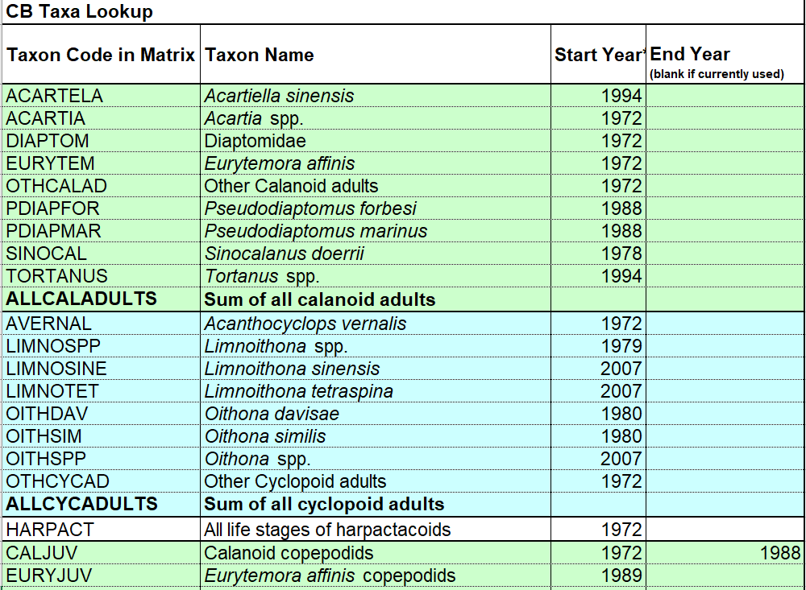
Some issues: Different taxa ID’d among years
CPUE’s for taxa that weren’t ID’d in certain years are 0 in datasets
Should code be used to correct these to NA?

Slide 12
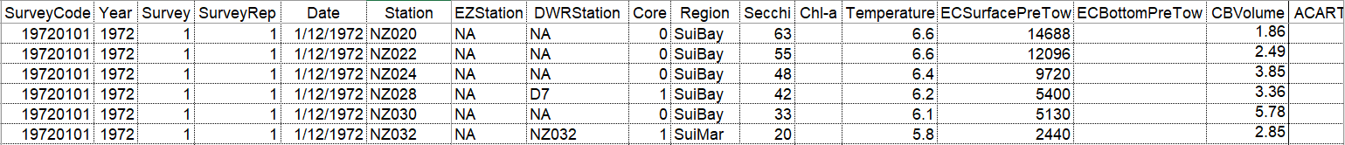
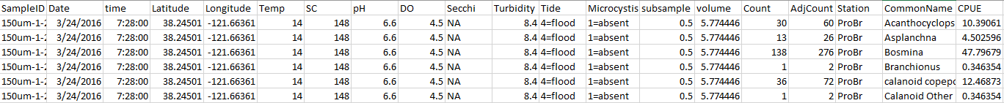
Some issues: Environmental variables
EMP:
FMWT:
FRP:

Slide 13
Other issues
CPUE vs Counts

Slide 14
Combining datasets
Datasets
EMP: CPUE data
FMWT: CPUE data
FRP: CPUE data
20mm: Count data and separate environmental data
R code to:
Select LCD taxa using crosswalk and hierarchy table
Select LCD taxa using crosswalk and hierarchy table
Select LCD taxa using crosswalk and hierarchy table
Calculate CPUE, combine environmental data with CPUE, Select LCD taxa using crosswalk and hierarchy table
Select for common environmental variables, incorporate lat/longs, and merge datasets
Combined dataset
Notes:
Pic of before and after datasets?
Show before datasets (excel file formats)

Slide 15
Madison’s code and issue with LCD approach
EMP
Pseudodiaptomus forbesii
Pseudodiaptomus marinus
FMWT
Pseudodiaptomus forbesii
Pseudodiaptomus marinus
20mm
Pseudodiaptomus spp.
Pseudodiaptomus forbesii
Pseudodiaptomus marinus
Pseudodiaptomus euryhalinus
+
Pseudodiaptomus spp. other
Combined data
EMP | FMWT | 20mm
 |  | Pseudodiaptomus spp. other
Pseudodiaptomus forbesii | Pseudodiaptomus forbesii | Pseudodiaptomus forbesii
Pseudodiaptomus marinus | Pseudodiaptomus marinus | Pseudodiaptomus marinus
 |  | Pseudodiaptomus euryhalinus
Notes:
From 20mm notes:
Pseudodiaptomus euryhalinus – all adults of this species (Not regularly ID’d)
Pseudodiaptomus forbesii – all adults of this species (2006 – present)
Pseudodiaptomus marinus – all adults of this species (2006 – present)
Pseudodiaptomus spp. – all adults of this genus not identifiable to species (1995 – present)

Slide 16
Madison’s code where LCD is valid
EMP
Tortanus spp.
FMWT
Tortanus spp.
20mm
Tortanus discaudatus
Tortanus dextrilobatus
Tortanus spp.
+
Tortanus spp.
Combined data
EMP | FMWT | 20mm
Tortanus spp. | Tortanus spp. | Tortanus spp.

Slide 17
Sam’s code where LCD is valid
EMP
Pseudodiaptomus forbesii
Pseudodiaptomus marinus
Pseudodiaptomus euryhalinus
FMWT
Pseudodiaptomus forbesii
Pseudodiaptomus marinus
Pseudodiaptomus euryhalinus
20mm
Pseudodiaptomus spp.
Pseudodiaptomus forbesii
+
+
+
All Pseudodiaptomus
All Pseudodiaptomus
All Pseudodiaptomus
Combined data
EMP | FMWT | 20mm
All Pseudodiaptomus | All Pseudodiaptomus | All Pseudodiaptomus
Pseudodiaptomus forbesii | Pseudodiaptomus forbesii | Pseudodiaptomus forbesii
Pseudodiaptomus marinus | Pseudodiaptomus marinus
Pseudodiaptomus euryhalinus | Pseudodiaptomus euryhalinus

Slide 18
Solution: Sum only to higher levels we can be confident were counted in entirety
EMP
Pseudodiaptomus forbesii
Pseudodiaptomus marinus
Other calanoids
FMWT
Pseudodiaptomus forbesii
Pseudodiaptomus marinus
Other calanoids
20mm
Pseudodiaptomus spp.
Pseudodiaptomus forbesii
Pseudodiaptomus marinus
Pseudodiaptomus euryhalinus
Other calanoids
+
+
+
All calanoids
All calanoids
All calanoids
Combined data
EMP | FMWT | 20mm
All calanoids | All calanoids | All calanoids
 |  | Pseudodiaptomus spp.
Pseudodiaptomus forbesii | Pseudodiaptomus forbesii | Pseudodiaptomus forbesii
Pseudodiaptomus marinus | Pseudodiaptomus marinus | Pseudodiaptomus marinus
 |  | Pseudodiaptomus euryhalinus
Other calanoids | Other calanoids | Other calanoids
Notes:
Or other calanoids?

Slide 19
Madison’s code where LCD is valid
EMP
Pseudodiaptomus spp.
Pseudodiaptomus forbesii
Pseudodiaptomus marinus
FMWT
Pseudodiaptomus spp.
Pseudodiaptomus forbesii
Pseudodiaptomus marinus
20mm
Pseudodiaptomus spp.
Pseudodiaptomus forbesii
Pseudodiaptomus marinus
Pseudodiaptomus euryhalinus
+
Pseudodiaptomus spp.
Combined data
EMP | FMWT | 20mm
Pseudodiaptomus spp. | Pseudodiaptomus spp. | Pseudodiaptomus spp.
Pseudodiaptomus forbesii | Pseudodiaptomus forbesii | Pseudodiaptomus forbesii
Pseudodiaptomus marinus | Pseudodiaptomus marinus | Pseudodiaptomus marinus
 |  | Pseudodiaptomus euryhalinus

